Slide 1
איפיון מוצר
שם האפליקציה: MOrello
חברי הצוות: נדב מורג, איריס אורון

Slide 2
Main Pages

Slide 3
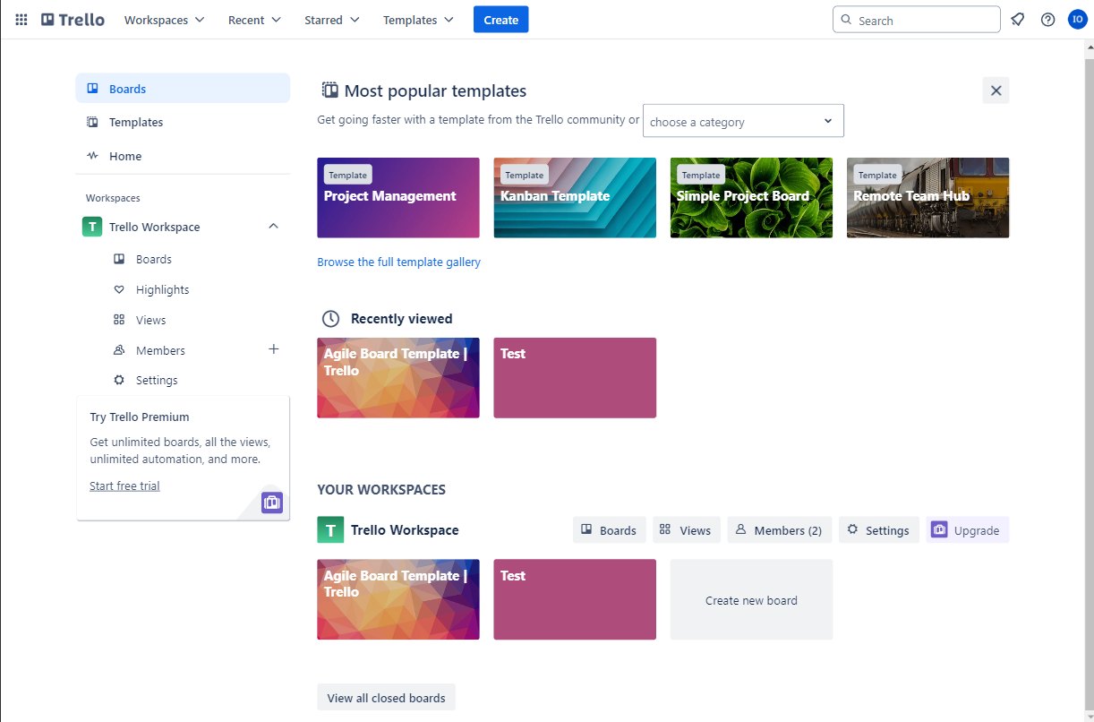
Boards page

Slide 4
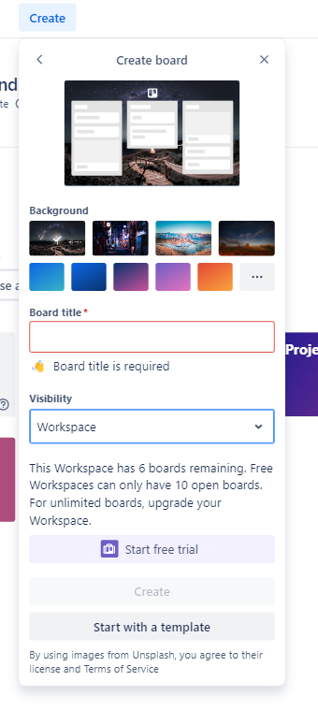
Create board modal

Slide 5
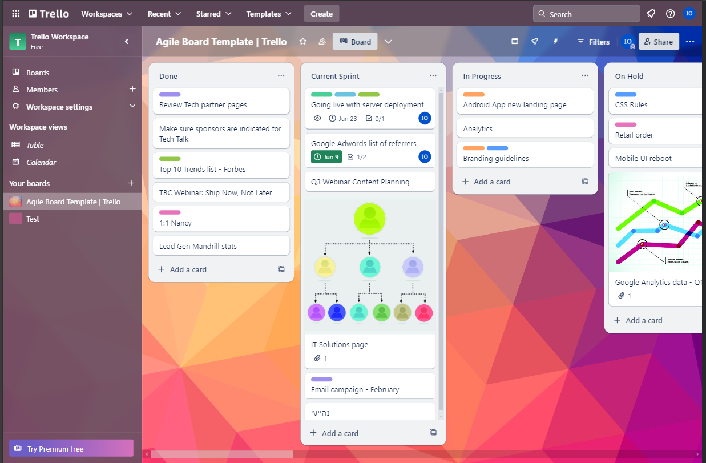
Tasks page

Slide 6
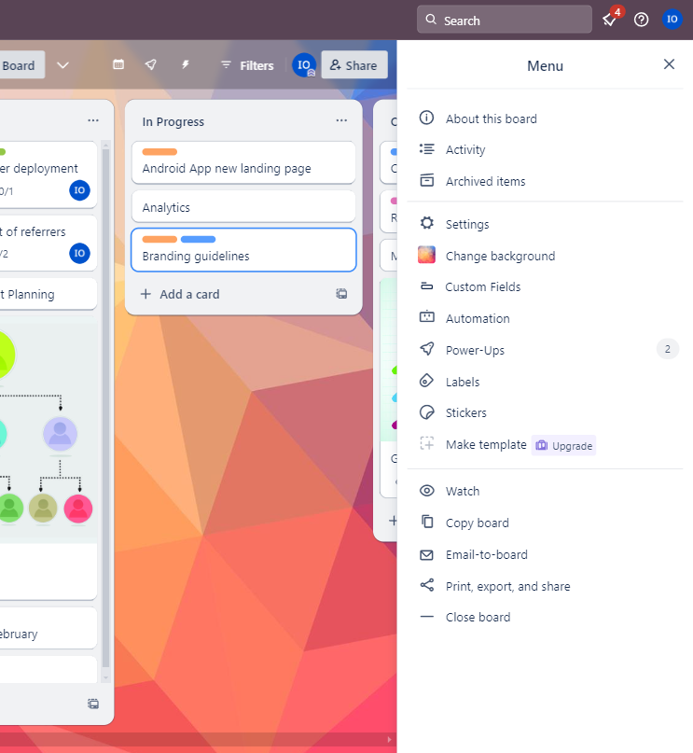
Tasks page menu

Slide 7
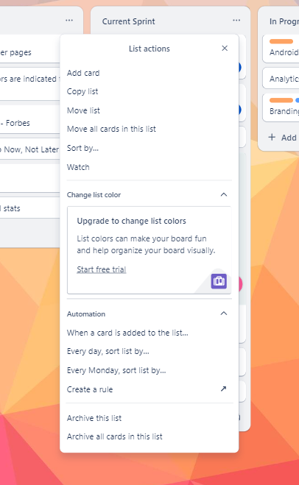
Group menu

Slide 8
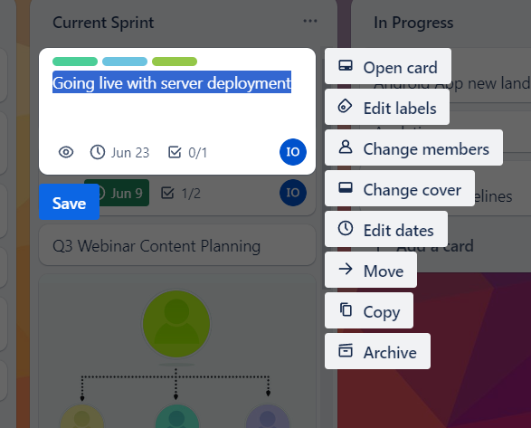
Task quick edit

Slide 9
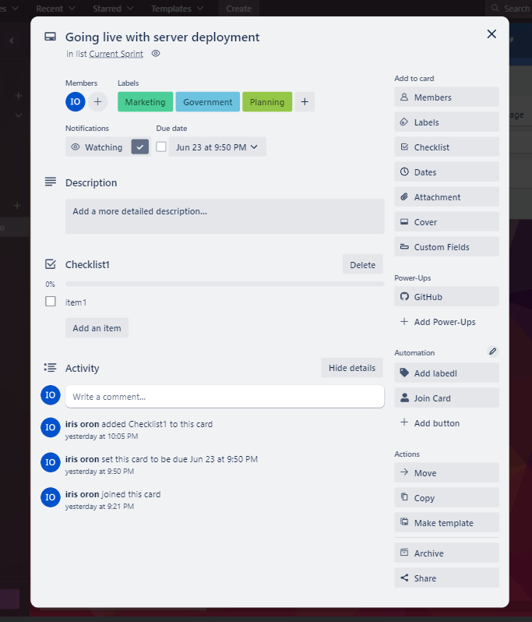
Task details

Slide 10
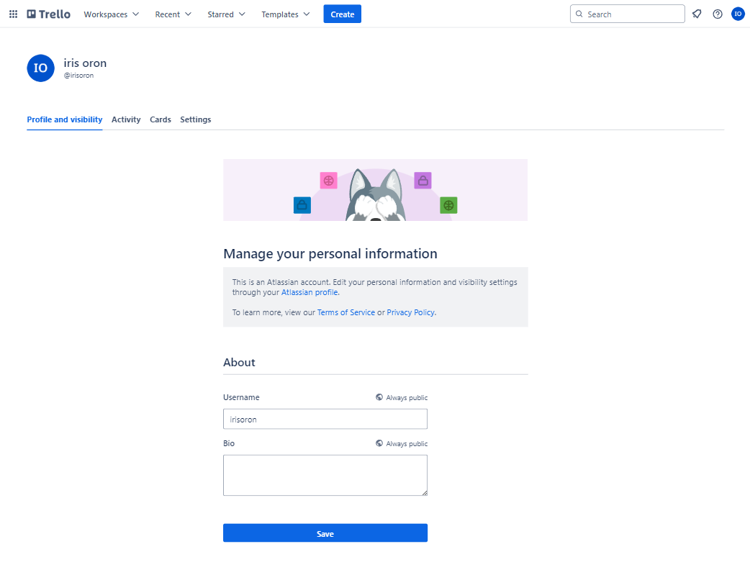
Profile page

Slide 11
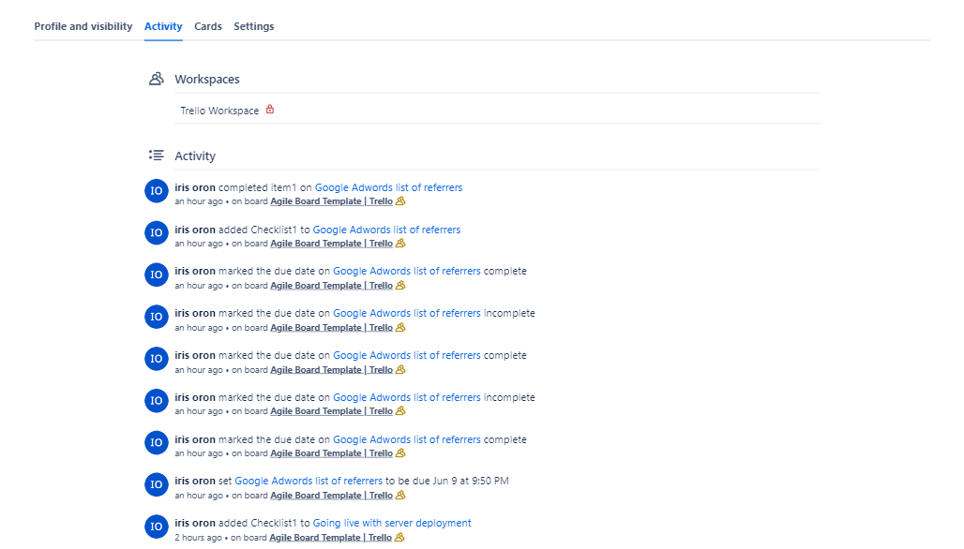
Profile page

Slide 12
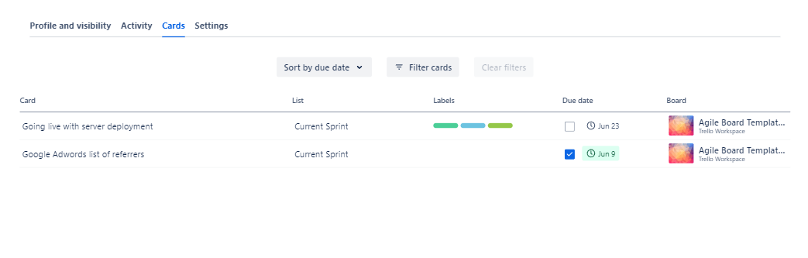
Profile page

Slide 13
Entities

Slide 14
Entities
Nice to have:
Board
List = Group
Card = Task:
Comment
Checklist+Todo
Attachment
Activity
Member
Label
Action
Workspace
Custom Field
Automation
Template

Slide 15
Main Flows

Slide 16
Flow
Homepage + Authentication
Boards page
Board
Task (card)

Slide 17
Add board
From the boards page click create
Enter name, visibility, background image
Click create

Slide 18
Flow

Slide 19
Backoffice
None

